Slide 1
3rd Party Coverage Report
County of San Diego

Slide 2
What does this report tell me?
This report can only show what has been entered by a person or uploaded and matched via MMEF.
It tells me what clients have insurance policies inserted in Anasazi- 3rd Party Coverage.
It tells me who the insurances are for each client.
It tells me if an insurance has been terminated.
It can also show some data entry errors.

Slide 3
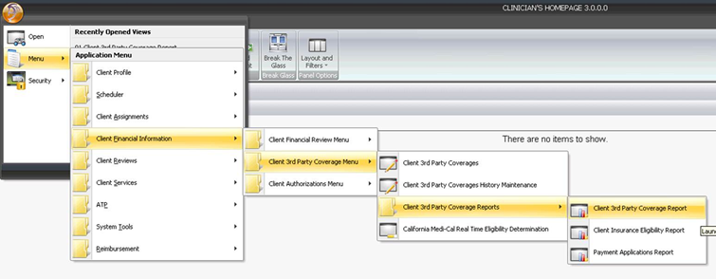
Where do I start?

Slide 4
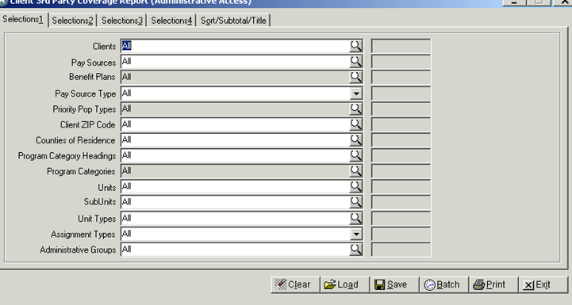
Load template
Click Load

Slide 5
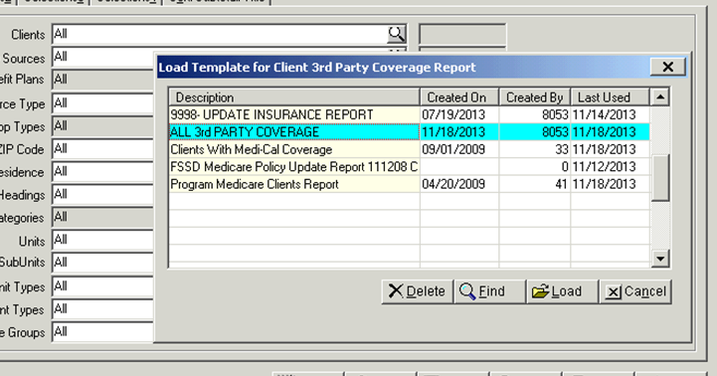
Choose the template for you
Select the Template “All 3rd PARTY COVERAGE:”
Then click on load

Slide 6
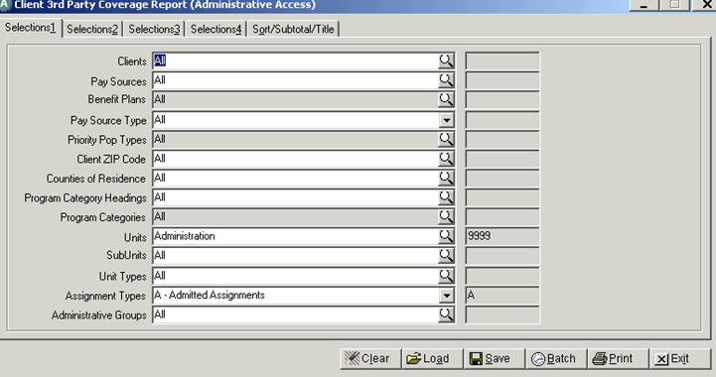
Tailor your report to your program. Tab 1
Change to your Unit/ SubUnit

Slide 7
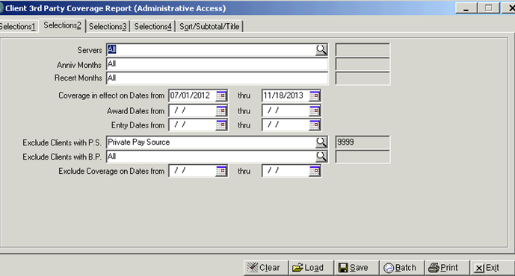
Tab2. Set your time frame
Enter date range that is still billable to Medi-Cal. (11months back)

Slide 8
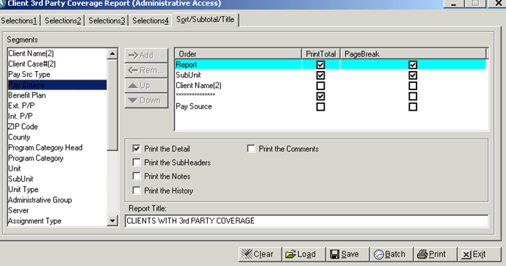
Go to Sort/Subtotal/Title Tab.
You can rename the report to show when you ran the report. (optional)
You’re ready to print.

Slide 9
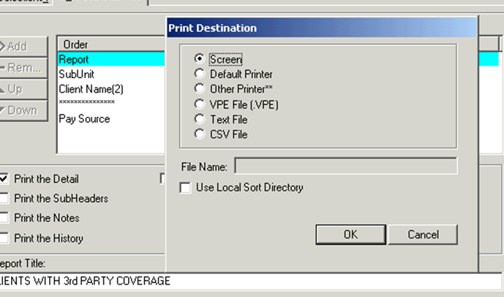
Print- OK

Slide 10
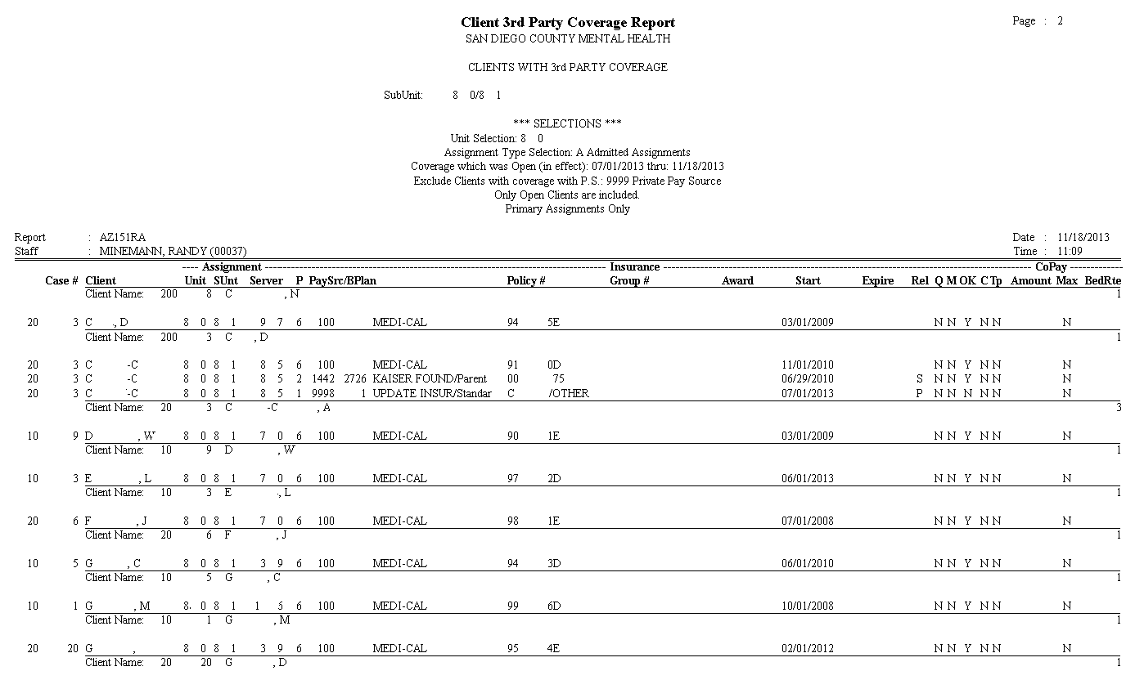
Your Report

Slide 11
When to Use this Report?
This report alerts you of your client’s Health Plan coverage prior to billing.
It allows you to cross check the validity of Pay Sources/Benefit Plans per client to avoid claim denials.
It allows you to identify where your services should be billing to first.
You can use this report as a reference when working on your other billing-related reports.

